Slide 1

INTRUSION DETECTION IN IoT BASED SYSTEMS
Presented By:
Abdoulbagui Alh Boubakari 160041086
Aly Abdelkader Gelany 160041087
Abdul Aziz yousufzai 160041088
Hamdan Harir 154452
Supervised by :
A. B. M. Ashikur Rahman
Asst. Professor,
Dept. of CSE, IUT
4-3-2021
Notes:
Introduce your self

Slide 2
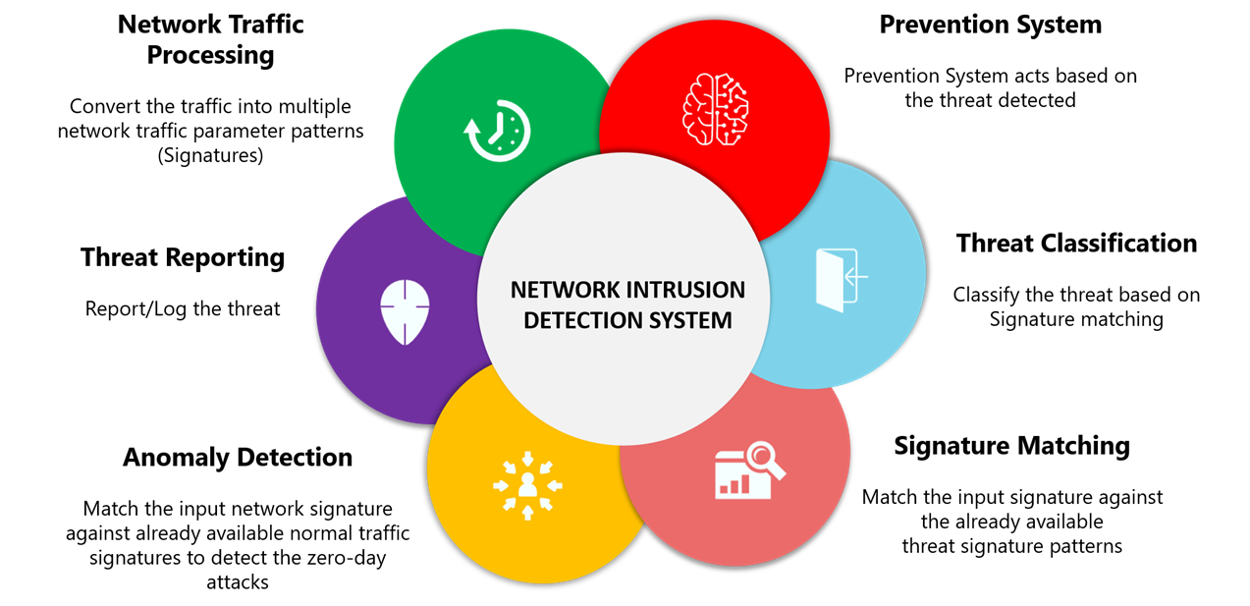
Introduction
Motivation
The Internet of Things (IoT): interconnected devices
The range of existing and potential Internet of Things devices is enormous
50 billions of devices
500 ZB data
600% attacks
Exponential growth of IoT devices in critical infrastructures
Vulnerability of wireless network
Privacy issues
Necessity of recognizing attacks

Slide 3
Challenges
Categorizing attacks
new Types of attacks constantly being created to bypass existing security measures
Bandwidth limitation
Use of wireless protocol
Loss of data
applicable due to the differences in IoT structure and behavior.
Time delay
Data transportation
High vulnerability to intrusion
attacker does not need physical access to system

Slide 4
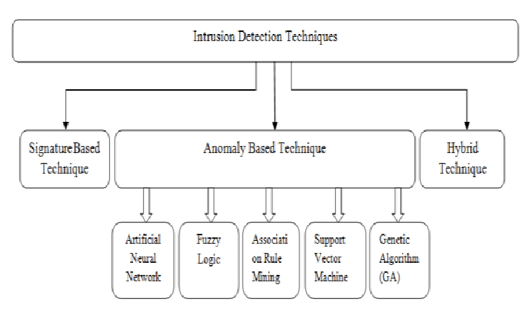
Background Study

Slide 5
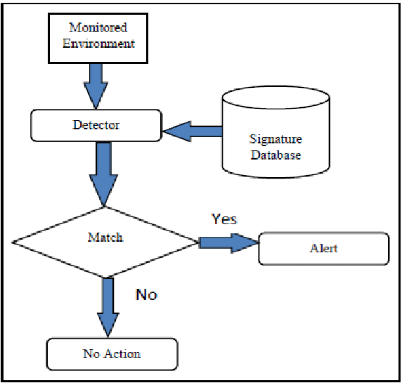
Signature Based IDS
Based on rules
High false negative rate
Adaptability problem
Ensemble methods, deep learning [1]
Navies bayes ,KNN classifier [7]
Clustering-based intrusion detection in IoT environments [13]

Slide 6
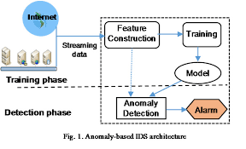
Anomaly based
Anomaly-based detection is used for changes in behavior.
Anomaly-based detection involves
Training with baseline
Comparing with baseline
Alert if not align with baseline.
Unsupervised learning on the IoT edge [4]
Statistical approach[10]
E-spion: A system-level IDS [9]

Slide 7
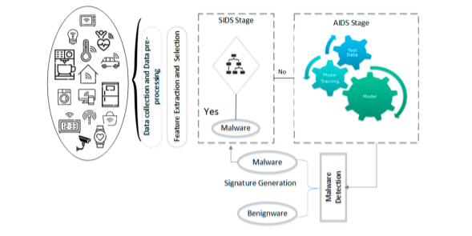
Hybrid IDS
Combine the results of SIDS and AIDS.
AIDS aims to profile the normal nodes activity and would raise a malicious alarm
SIDS will have an appropriate history of previously known attacks.
clustering and classification based on outlier detection [6]
A novel Ensemble of Hybrid Intrusion Detection System [12]
Performance evaluation of a combined anomaly detection platform [14]

Slide 8
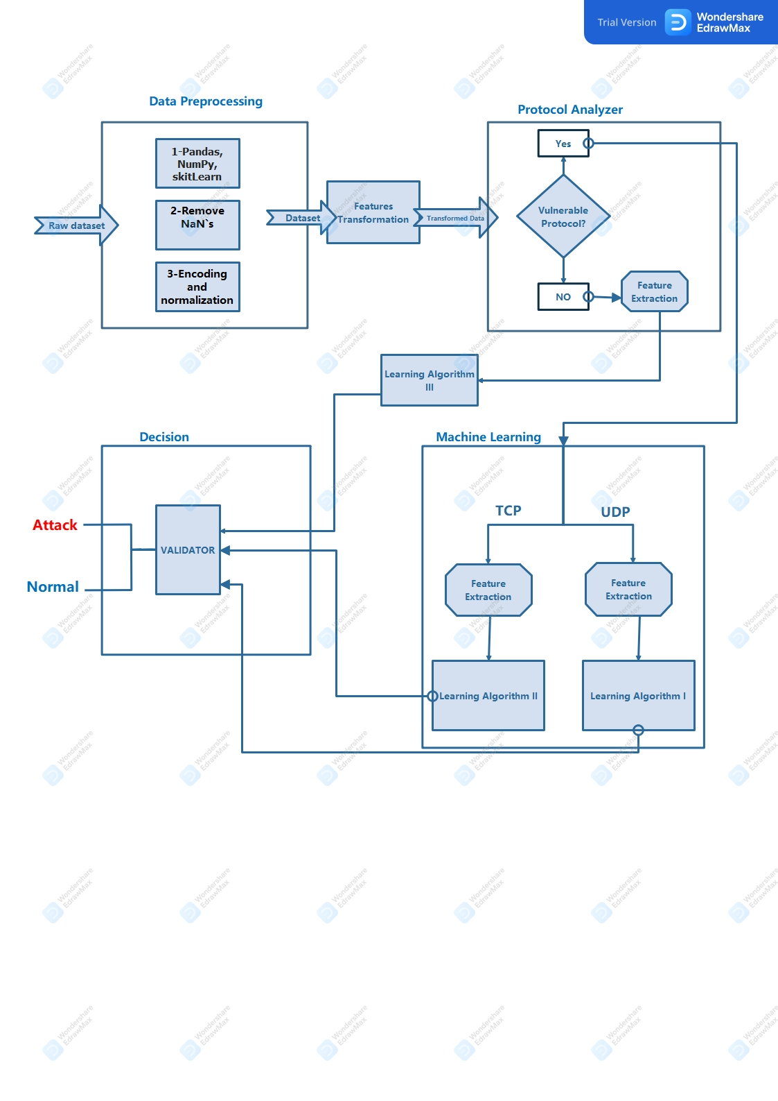
The Proposed Model

Slide 9
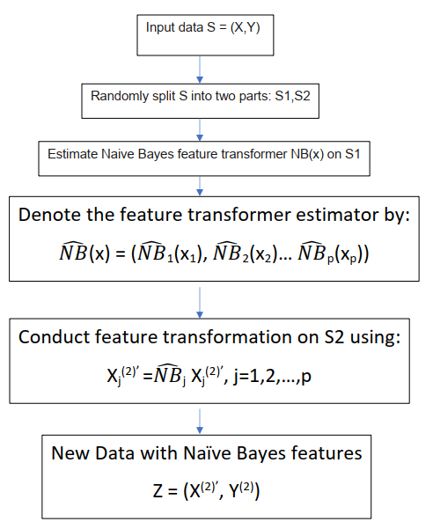
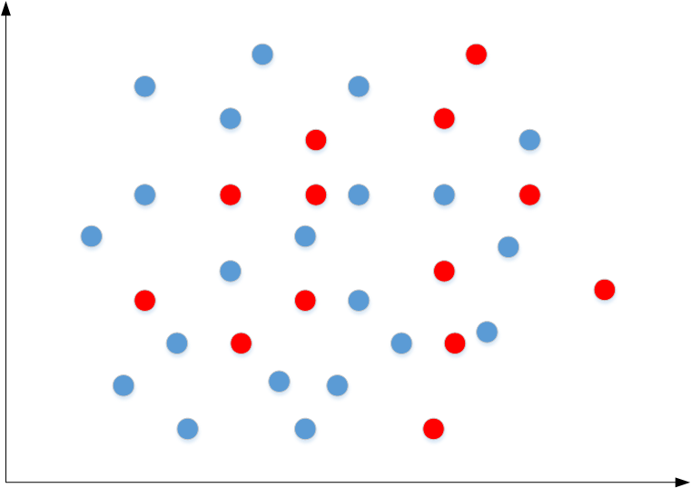
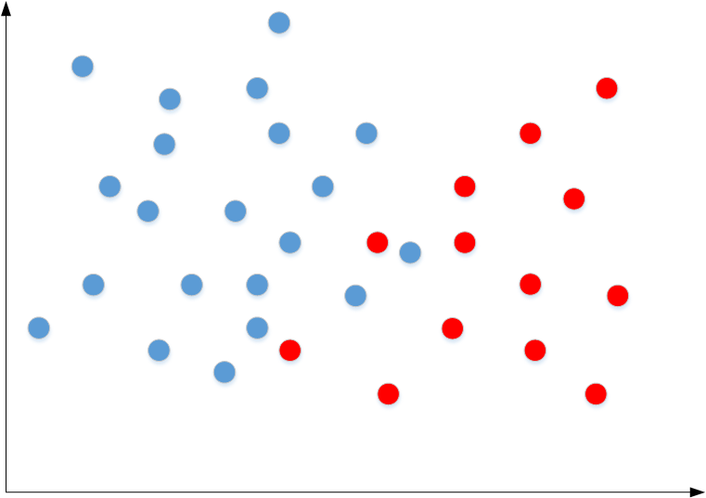
Future Transformation
Based on Bayesian decision theory
improve the data quality
Helps in distinguishing between normal and the malicious activity sharing similar characteristics
(a) original data
(b) transformed data

Slide 10
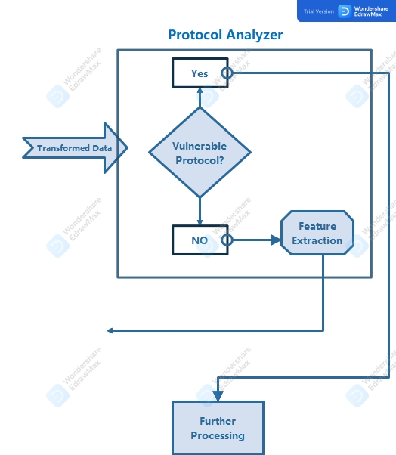
Protocol Analyzer
Filters the network packets and identifies vulnerable protocols
helps to avoid burdening network servers with unnecessary computational load

Slide 11
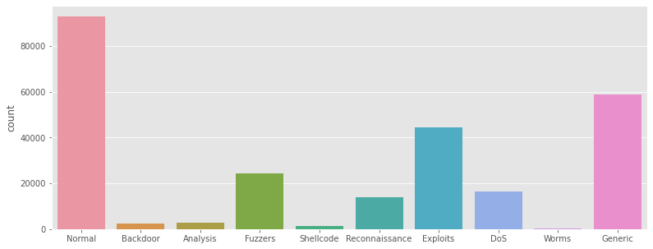
Dataset
Dataset Name: UNSW-NB15
Data type: hybrid of real modern normal activities and synthetic contemporary attack behaviors
Total features: 49
The number of records in the training set: 175,341
The number of records in the testing set: 82,332
Categories of attack: 9 (Fuzzers, Analysis, Backdoors, DoS, Exploits, Generic, Reconnaissance, Shellcode and Worms)
Dataset Name: NSL-KDD
Data type: hybrid of real modern normal activities and synthetic contemporary attack behaviors
Total features: 43
The number of records in the training set: 175,341
The number of records in the testing set: 82,332
Categories of attack: 9 (Fuzzers, Analysis, Backdoors, DoS, Exploits, Generic, Reconnaissance, Shellcode and Worms)
Attack Type Classification

Slide 12
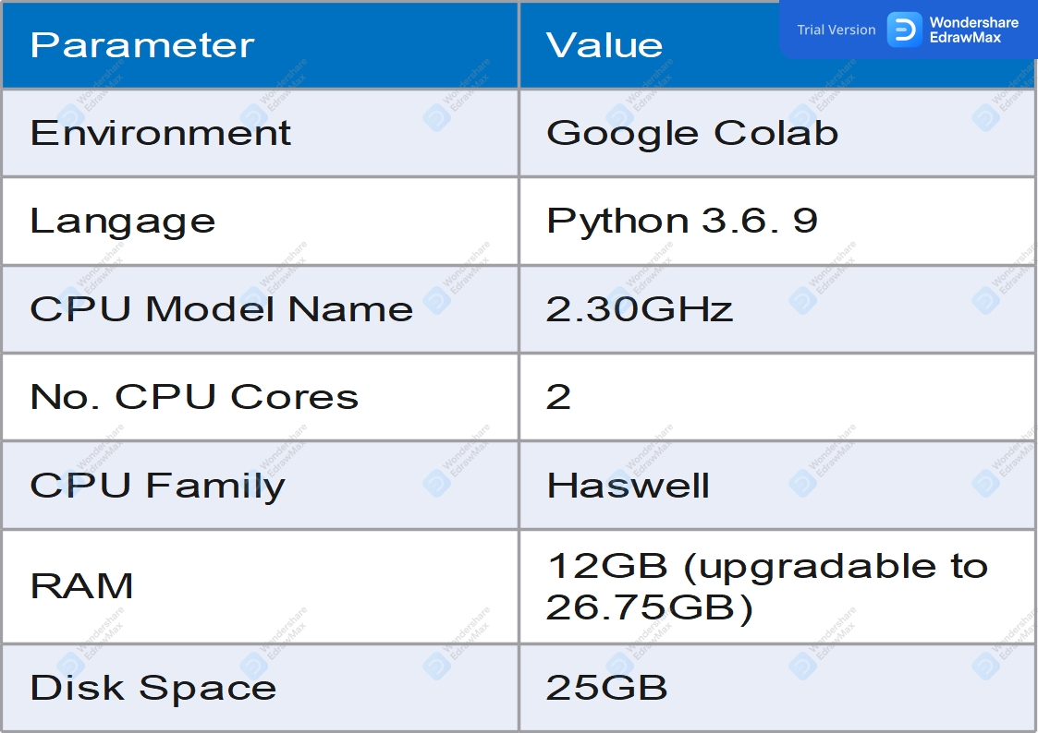
Implementation Environment

Slide 13
Results and Analyzes

Slide 14
Model Name | Feature selection | Test Accuracy | Test Precision | F-1 Score Test | Recall
KNN | RFE | 0.63 | 0.94 | 0.73 | 0.63
 | CHi2 | 0.05 | 0.00 | 0.01 | 0.05
KNN with Feature transform | RFE | 0.95 | 0.90 | 0.92 | 0.95
 | CHi2 | 0.36 | 084 | 0.50 | 0.36
LR | RFE | 0.55 | 0.30 | 0.39 | 0.55
 | CHi2 | 0.80 | 0.85 | 0.80 | 0.80
LR with Feature transform | RFE | 0.67 | 0.72 | 0.66 | 0.67
 | CHi2 | 0.46 | 0.75 | 0.30 | 0.46
MLP | RFE | 0.84 | 0.94 | 0.90 | 0.86
 | CHi2 | 1.00 | 1.00 | 1.00 | 1.00
MLP with Feature transform | RFE | 1.00 | 1.00 | 1.00 | 1.00
 | CHi2 | 1.00 | 1.00 | 1.00 | 1.00

Slide 15
Results and analyzes

Slide 16
Conclusion
In previous works, Feature transformation and protocol analyzer were used separately [15][16].
Our proposed model by combining these two approaches has proven to be more efficient based on metrics such as accuracy, precision and recall.
Our models achieved higher accuracy by using the RFE feature selection and efficiently detected normal packets from attack packets.
The proposed model can accurately be used to detect previously seen and unseen attacks which effectively makes it Hybrid.

Slide 17
Future Plan
We will try to use Misuse detection by profiling users behaviors:
This refers to the process of learning how many times a user will send a request to the smart home system using his smart devices such as a smartphone or smart tablet information from the sensor data.
Classification of attacks: as our actual work is based on just detecting if a data packet is an attack or a normal packet, we wish to perform classification of attack based on their type.

Slide 18
References
[1] J. O.-G. A. L. M.-C. I. G. Hector Alaiz-Moreton, Jose Aveleira-Mata andC. Benavides, “Multiclass classification procedure for detecting attacks onmqtt-iot protocol,” 2019
[2] C. G. Tianqi Chen, “Xgboost: A scalable tree boosting system,” 2016.
[3] C. G. e. a. K. Cho, B. van Merrienboer, “Learning phrase representations using rnn encoder-decoder for statistical machine translation,” 2014.
4] M. A. F. A. Zaffar Haider Janjua, Massimo Vecchio, “Irese: An intelligentrare-event detection system using unsupervised learning on the iot edge,”2019.
[5] D. S. Robert P. Markiewicz, “Clust-it: Clustering-based intrusion detectionin iot environments,” 2020.
[6] S. Sandosh, V. Govindasamy, and G. Akila, “Enhanced intrusion detection system via agent clustering and classification based on outlier detection,”Peer-to-Peer Networking and Applications, pp. 1–8, 2020.
[7] H. H. Pajouh, R. Javidan, R. Khayami, D. Ali, and K.-K. R. Choo, “A two-layer dimension reduction and two-tier classification model for anomaly-based intrusion detection in iot backbone networks,”IEEE Transactions on Emerging Topics in Computing, 2016.
[8] D. Zheng, Z. Hong, N. Wang, and P. Chen, “An improved lda-based elm classification for intrusion detection algorithm in iot application,”Sensors,vol. 20, no. 6, p. 1706, 2020.
[9] A. Mudgerikar, P. Sharma, and E. Bertino, “E-spion: A system-level intrusion detection system for iot devices,” inProceedings of the 2019 ACMAsia Conference on Computer and Communications Security, pp. 493–500,2019.

Slide 19
References (cont..)
[10] M. Niedermaier, M. Striegel, F. Sauer, D. Merli, and G. Sigl, “Efficient intrusion detection on low-performance industrial iot edge node devices,”arXiv preprint arXiv:1908.03964, 2019.
[11] M. Eskandari, Z. H. Janjua, M. Vecchio, and F. Antonelli, “Passban ids: An intelligent anomaly based intrusion detection system for iot edge devices,”IEEE Internet of Things Journal, 2020.
[12] Khraisat, A.; Gondal, I.; Vamplew, P.; Kamruzzaman, J.; Alazab, A. A Novel Ensemble of Hybrid Intrusion Detection System for Detecting Internet of Things Attacks. Electronics 2019, 8, 1210.
[13] D. S. Robert P. Markiewicz, “Clust-it: Clustering-based intrusion detection in iot environments,”2020.
[14] M. Monshizadeh, V. Khatri, B. G. Atli, R. Kan-tola, and Z. Yan, “Performance evaluation of a combined anomaly detection platform,” IEEE Access, vol. 7, pp. 100964–100978, 2019
[15] F. Alghayadh and D. Debnath, “A hybrid intrusion detection system for smart home security based on machine learning and user behavior, "Advances in Internet of Things, vol. 11, no. 1,pp. 10–25, 2021
[16] Jie Gu, Shan Lu, An effective intrusion detection approach using SVM with naıve Bayes feature embedding, Computers & Security (2020), doi: https://doi.org/10.1016/j.cose.2020.102158

